Slide 1
Assortivity HIV Tested Positive Status Example

Slide 2
Form Relationships Based On Tested Positive for HIV Status
Goal: See how the impact of forming relationships based on the individual receiving the results from HIV Test affects the spread of the disease. This is different from HIV_TESTED_POSITIVE_STATUS in that the person needs to have been tested AND received the results versus just being tested.
Expect: Forming relationships with like status should reduce the spread of the disease.
Re-occurring HIVRapidHIVDiagnostic so that we can test people on are infected or not.
25% of population infected at outbreak.
Initial Population = 175,000
Overridden from Defaults
"Report_Relationship_Start" : 1,
"PFA_Cum_Prob_Selection_Threshold": 0.2,
"PFA_Update_Period_Transitory" : 30,
"PFA_Update_Period_Informal" : 30,
"PFA_Update_Period_Marital" : 30

Slide 3
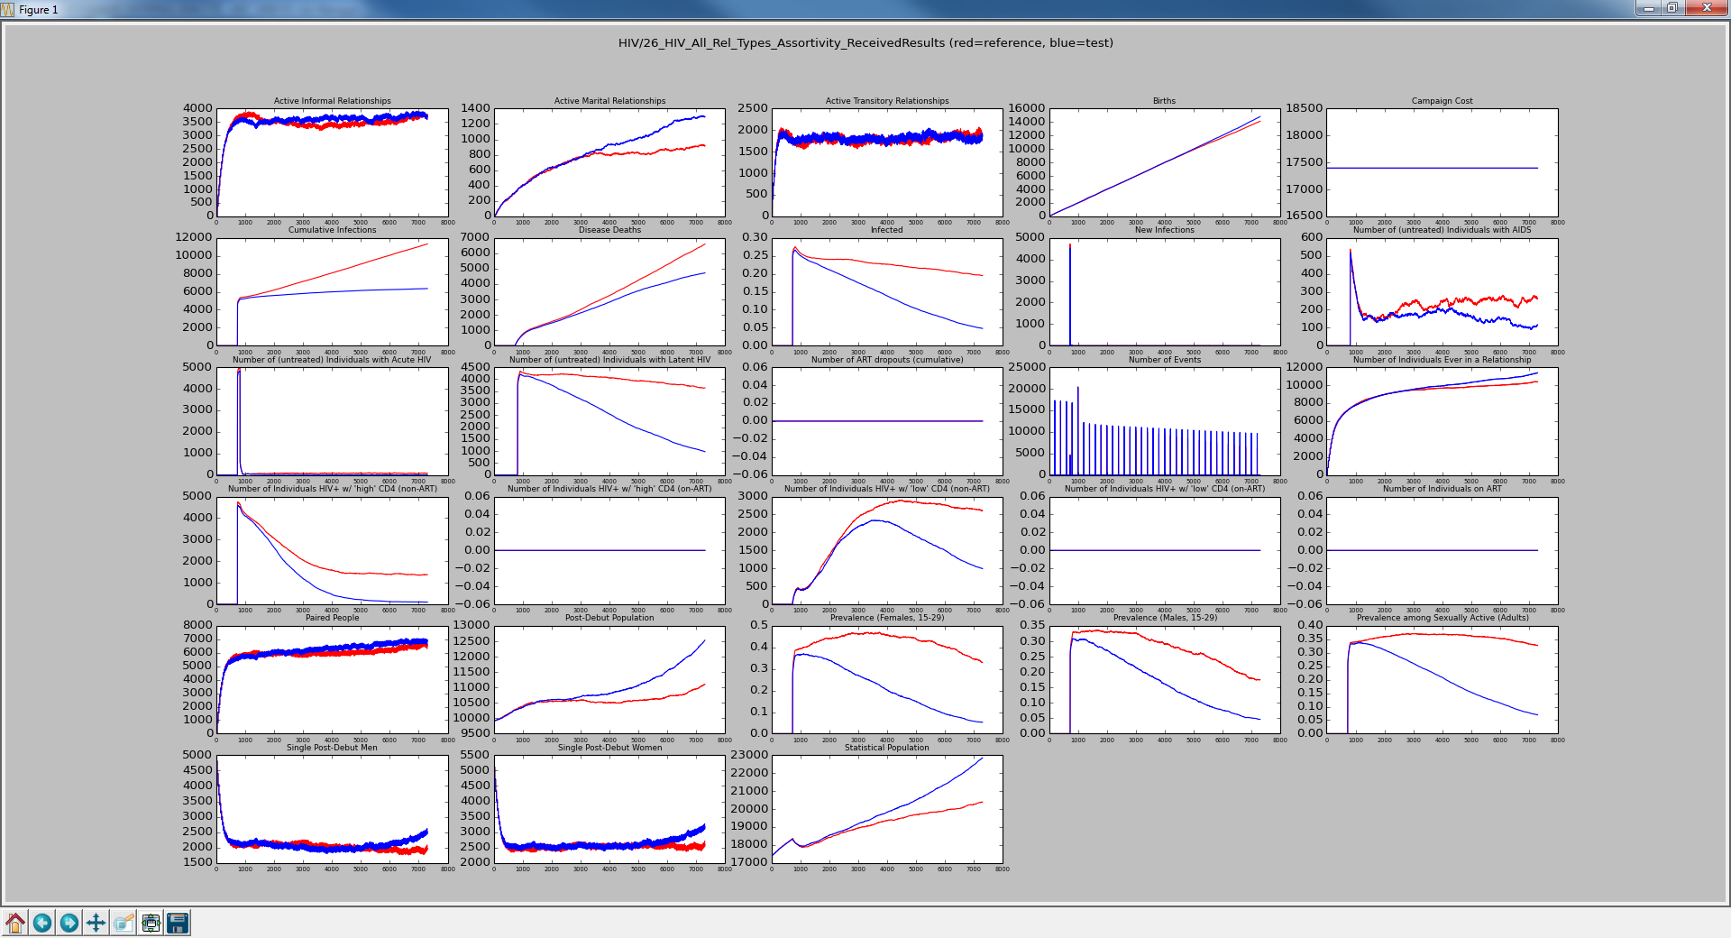
Red is All Types with No Groups Blue is All Types with Matrix
[1.0, 0.0, 0.0],
[0.0, 1.0, 0.0],
[0.0, 0.0, 1.0]
Notice the constant rate of events. These are HIV Testing events that occur every 200 days. No mixed relationships means less spread of infection.

Slide 4
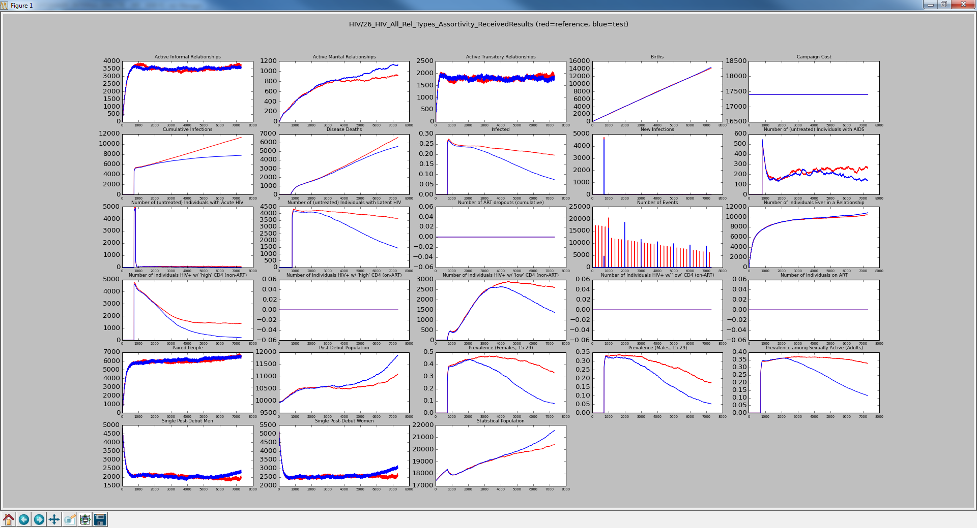
Red is All Types with No Groups Blue is All Types with Matrix
[1.0, 0.0, 0.0],
[0.0, 1.0, 0.0],
[0.0, 0.0, 1.0]
Change the HIV Test to every 1000 days and see increase in infection and deaths.

Slide 5
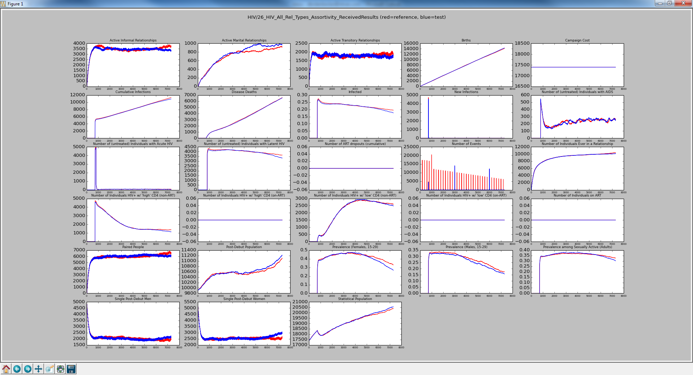
Red is All Types with No Groups Blue is All Types with Matrix
[1.0, 0.0, 0.0],
[0.0, 1.0, 0.0],
[0.0, 0.0, 1.0]
Change the HIV Test to every 3000 days and there is almost no benefit. People don’t know their status.

Slide 6
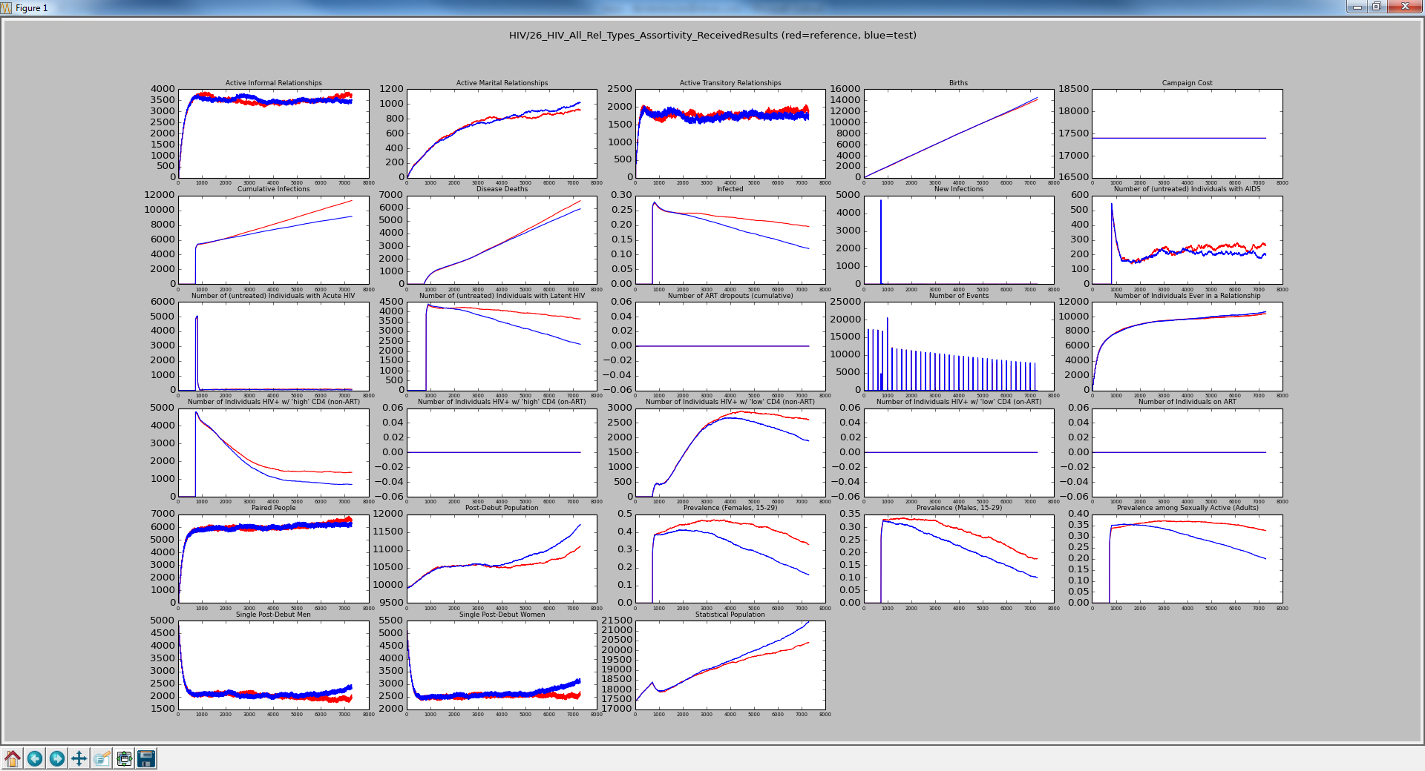
Red is All Types with No Groups Blue is All Types with Matrix
[1.0, 0.0, 0.0],
[0.0, 1.0, 0.0],
[0.0, 0.0, 1.0]
Back to testing every 200 days but change the Probability_Received_Result from 1.0 to 0.5. See that infection his higher than the first slide because people don’t know their status.

Slide 7
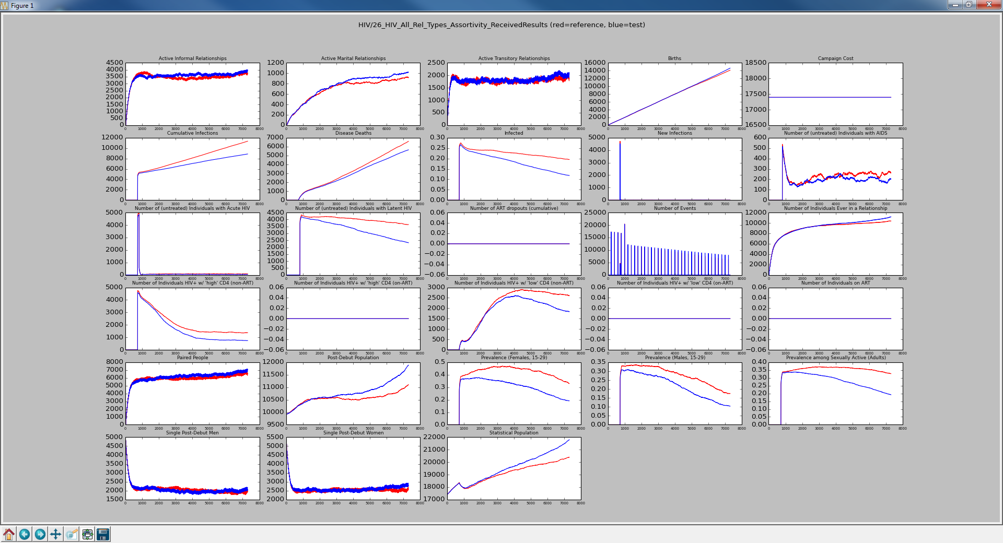
Red is All Types with No Groups Blue is All Types with Matrix
[0.8, 0.1, 0.1],
[0.1, 0.8, 0.1],
[0.1, 0.1, 0.8]
Back to HIV Testing every 200 days and Probability_Received_Result=1.0, but allow for mixed relationships. Slight increase in number of infections compared to 1’s on the diagonal.

Slide 8

Red is All Types with No Groups Blue is All Types with Matrix
[0.7, 0.1, 0.2],
[0.2, 0.7, 0.1],
[0.2, 0.1, 0.7]
Not much change but we are not forcing the relationships that will cause the spread.

Slide 9

Red is All Types with No Groups Blue is All Types with Matrix
[0.6, 0.1, 0.3],
[0.3, 0.6, 0.1],
[0.3, 0.1, 0.6]
Same deal

Slide 10
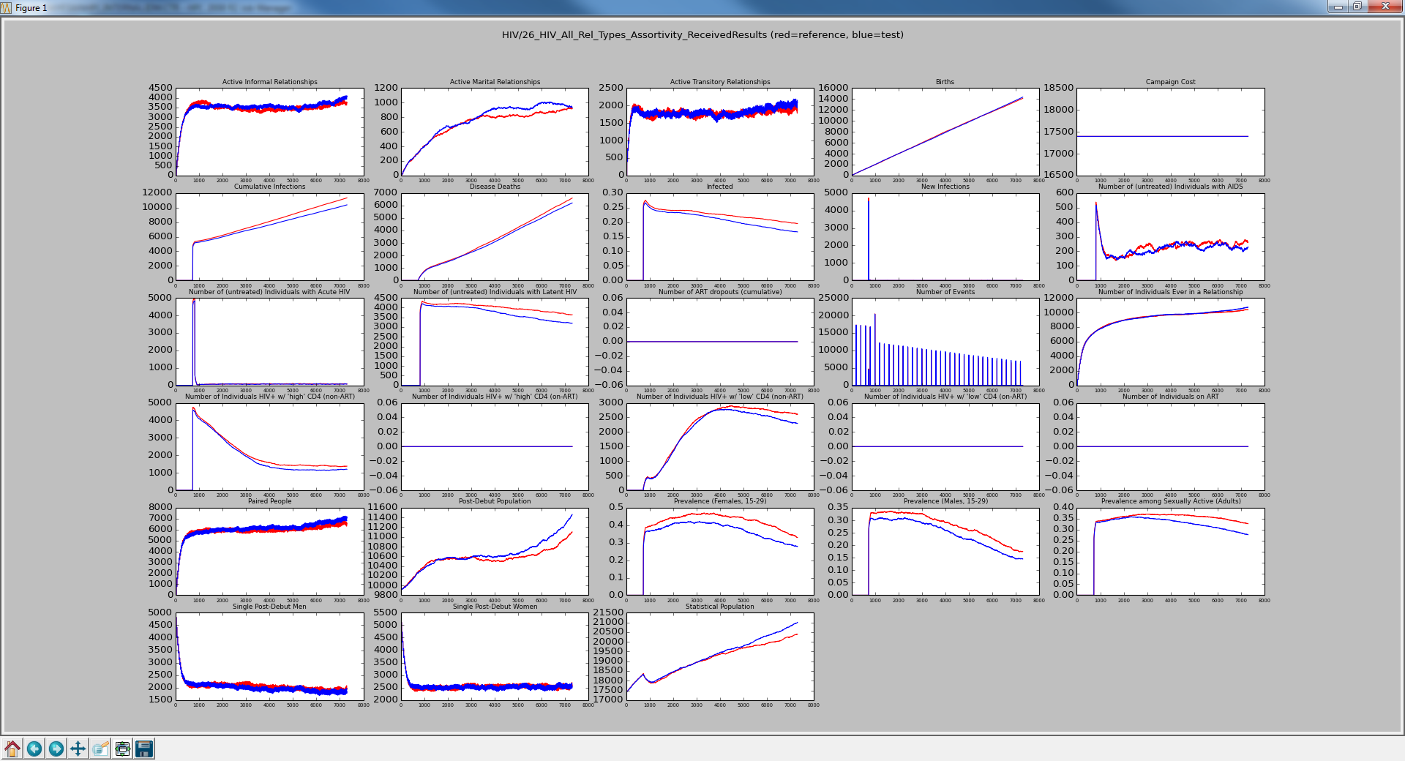
Red is All Types with No Groups Blue is All Types with Matrix
[0.6, 0.3, 0.1],
[0.1, 0.6, 0.3],
[0.1, 0.3, 0.6]
Instead of having off diagonal relationships be non-spreading, we increased the distribution of relationships that can spread the disease.

Slide 11

Red is All Types with No Groups Blue is All Types with Matrix
[0.5, 0.4, 0.1],
[0.1, 0.5, 0.4],
[0.1, 0.4, 0.5]
More from the diagonals to the spreading type relationships causes continued increase in the spread.

Slide 12
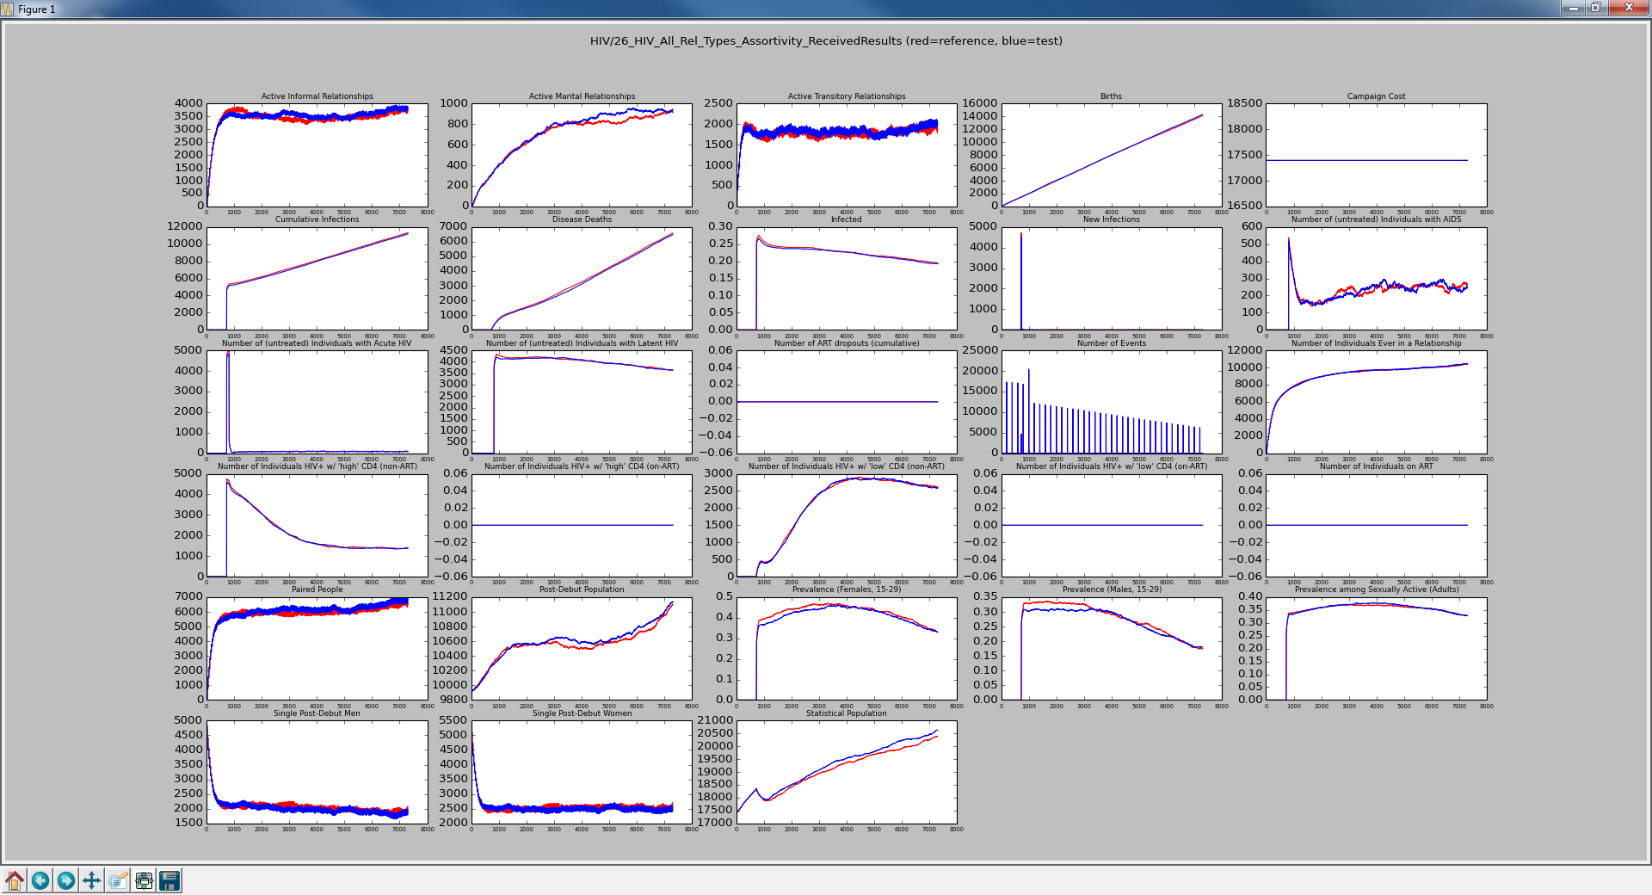
Red is All Types with No Groups Blue is All Types with Matrix
[0.5, 0.5, 0.5],
[0.5, 0.5, 0.5],
[0.5, 0.5, 0.5]
The same as NO_GROUPS

Slide 13

Red is All Types with No Groups Blue is All Types with Matrix
[0.3, 0.6, 0.1],
[0.1, 0.3, 0.6],
[0.1, 0.6, 0.3]
More to the spreading relationships but not as much increase in the disease as one might expect.

Slide 14

Red is All Types with No Groups Blue is All Types with Matrix
[0.2, 0.7, 0.1],
[0.1, 0.2, 0.7],
[0.1, 0.7, 0.2]
The spread is increasing but again not by a lot.

Slide 15

Red is All Types with No Groups Blue is All Types with Matrix
[0.1, 0.8, 0.1],
[0.1, 0.1, 0.8],
[0.1, 0.8, 0.1]
Same deal

Slide 16
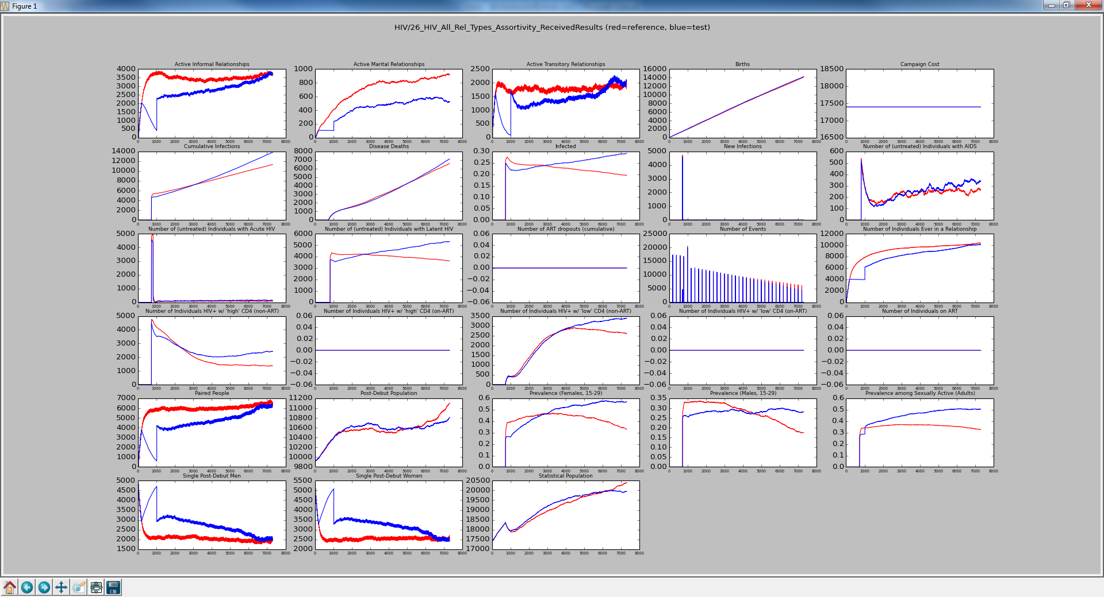
Red is All Types with No Groups Blue is All Types with Matrix
[0.1, 0.9, 0.0],
[0.1, 0.0, 0.9],
[0.1, 0.9, 0.0]
Not sure what to make of this. We can see the zeros limiting relationships being formed which initially causes a reduction in deaths but then the non-zero values take over.

Slide 17
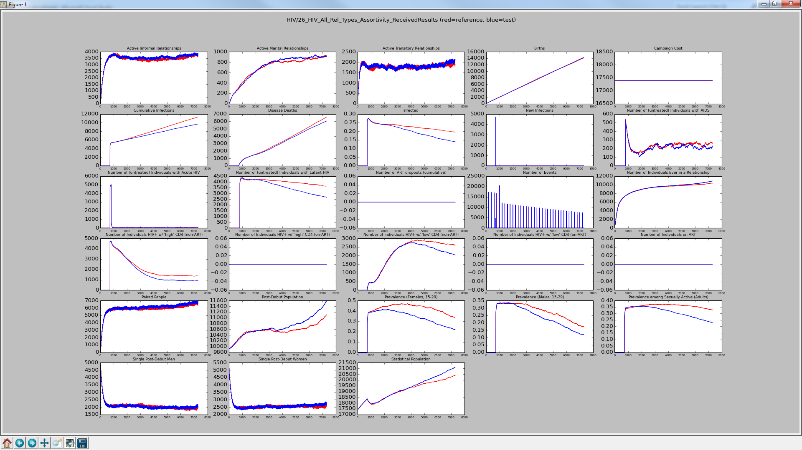
Red is All Types with No Groups Blue is All Types with Matrix
[0.8, 0.1, 0.1],
[0.1, 0.8, 0.1],
[0.1, 0.1, 0.8]
Checked-in
"Probability_Received_Result" : 0.9

Slide 18
Test Update
The Retest_Until_Positive feature was removed and some other things have changed since the first set of slides were created.
On 6/19/2015, we will replace the Retest_Until_Positive feature with the Number_Repetitions feature in the StandardEventCoordinator.
After showing the similarity, we will shorten the runtime of the test.

Slide 19
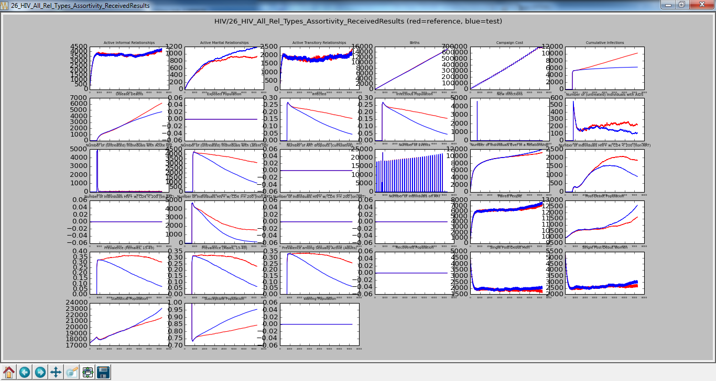
Red is All Types with No Groups Blue is All Types with Matrix
[1.0, 0.0, 0.0],
[0.0, 1.0, 0.0],
[0.0, 0.0, 1.0]
"Probability_Received_Result" : 0.9
“Simulation Duration” : 7300

Slide 20
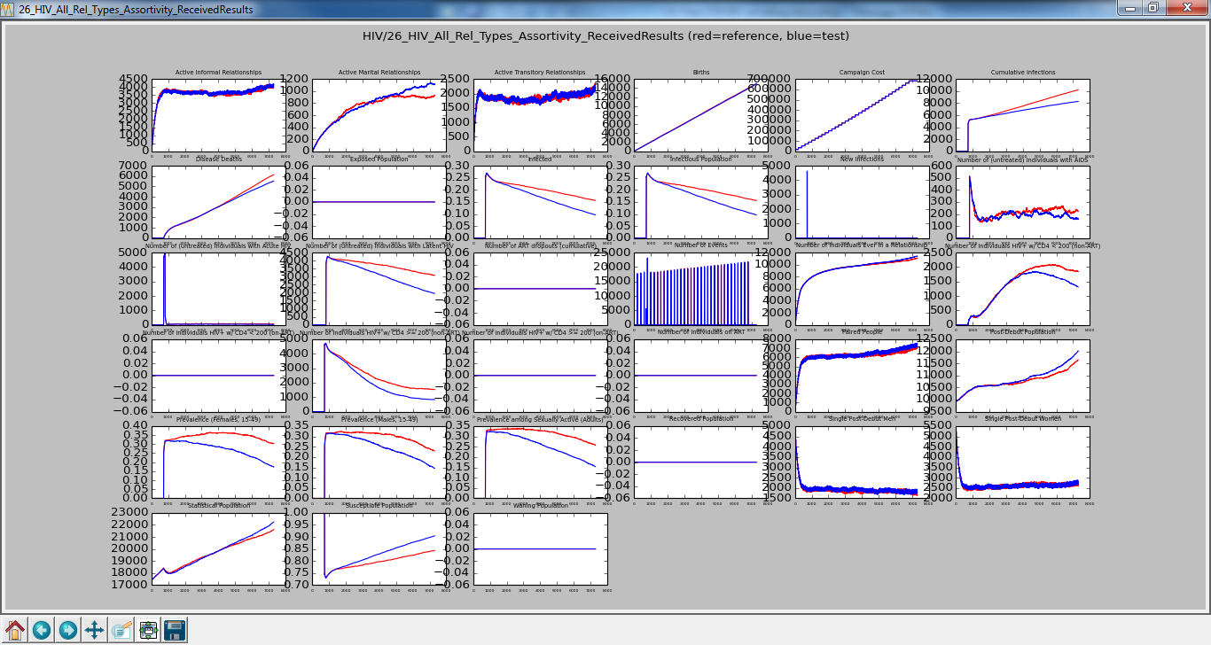

Red is All Types with No Groups Blue is All Types with Matrix
[0.8, 0.1, 0.1],
[0.1, 0.8, 0.1],
[0.1, 0.1, 0.8]
Similar to previous baseline

Slide 21
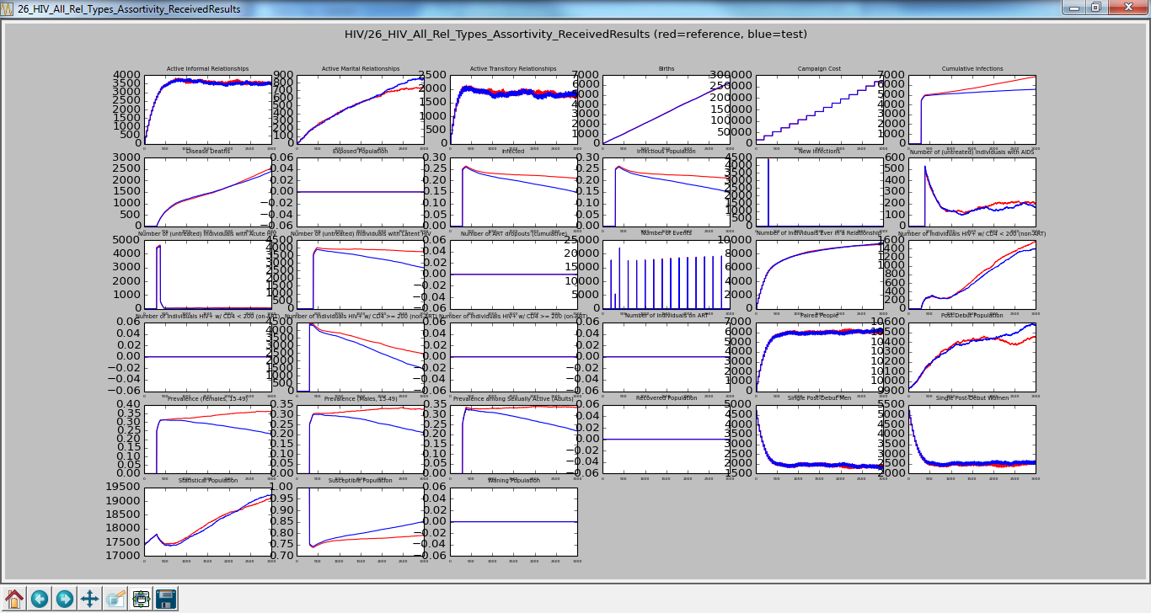
Red is All Types with No Groups Blue is All Types with Matrix
[1.0, 0.0, 0.0],
[0.0, 1.0, 0.0],
[0.0, 0.0, 1.0]
“Simulation Duration” : 3000
Reducing the duration from 7300 to 3000 shortens the run time from over 5 minutes to less than 2.5 minutes. I tried 2000 but it did not show enough difference.

Slide 22
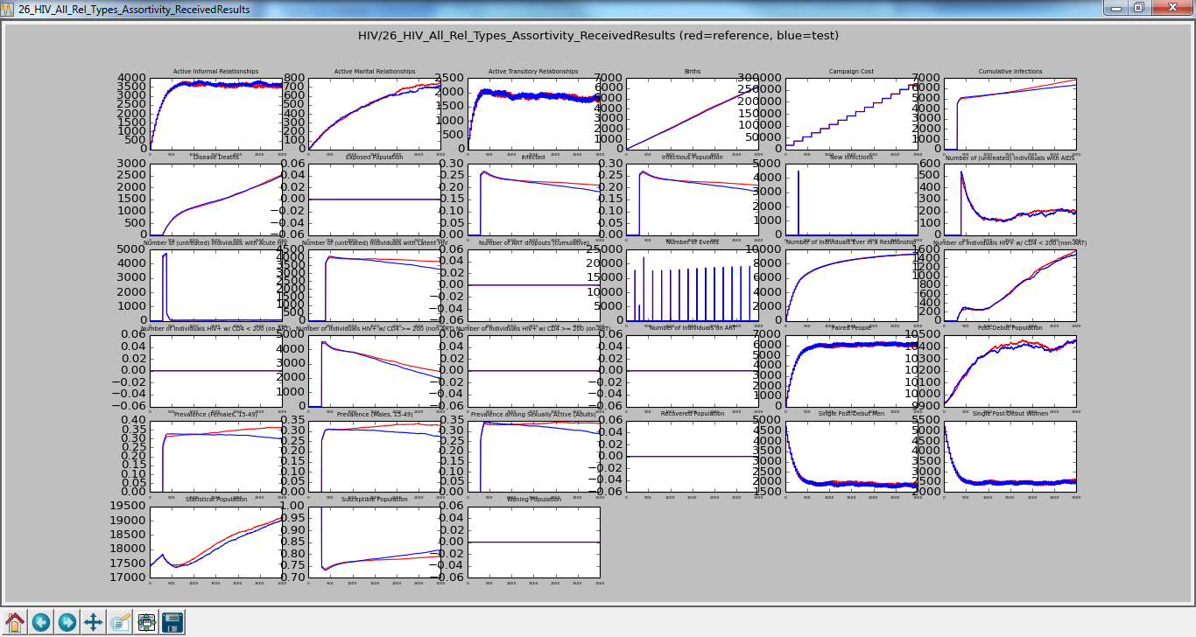
Red is All Types with No Groups Blue is All Types with Matrix
[0.8, 0.1, 0.1],
[0.1, 0.8, 0.1],
[0.1, 0.1, 0.8]
“Simulation Duration” : 3000
Checked-In

